Slide 1
Windows 10 Module 7
Managing Windows Security

Slide 2
Module Objectives
Use Security and Maintenance
Manage Windows Firewall
Manage automatic updates
Defend against malicious software
Protect your Internet privacy
Delete Internet information
Set Family Safety controls

Slide 3
Use Security and Maintenance (Slide 1 of 3)
Security and Maintenance
Access from the Control Panel
Provides a single place to view alerts and take actions
Action Center displays security alerts and icons as you work in Windows 10
Notification area of taskbar also makes you aware of potential security risks

Slide 4
Use Security and Maintenance (Slide 2 of 3)
A computer virus is a program that attaches itself to a file, reproduces itself, and spreads to other files
A worm can spread without human action across networks
A Trojan horse is a program that appears useful but causes problems
Antivirus software examines files to determine if they are infected
Windows Defender
Free software that protects against viruses and spyware

Slide 5
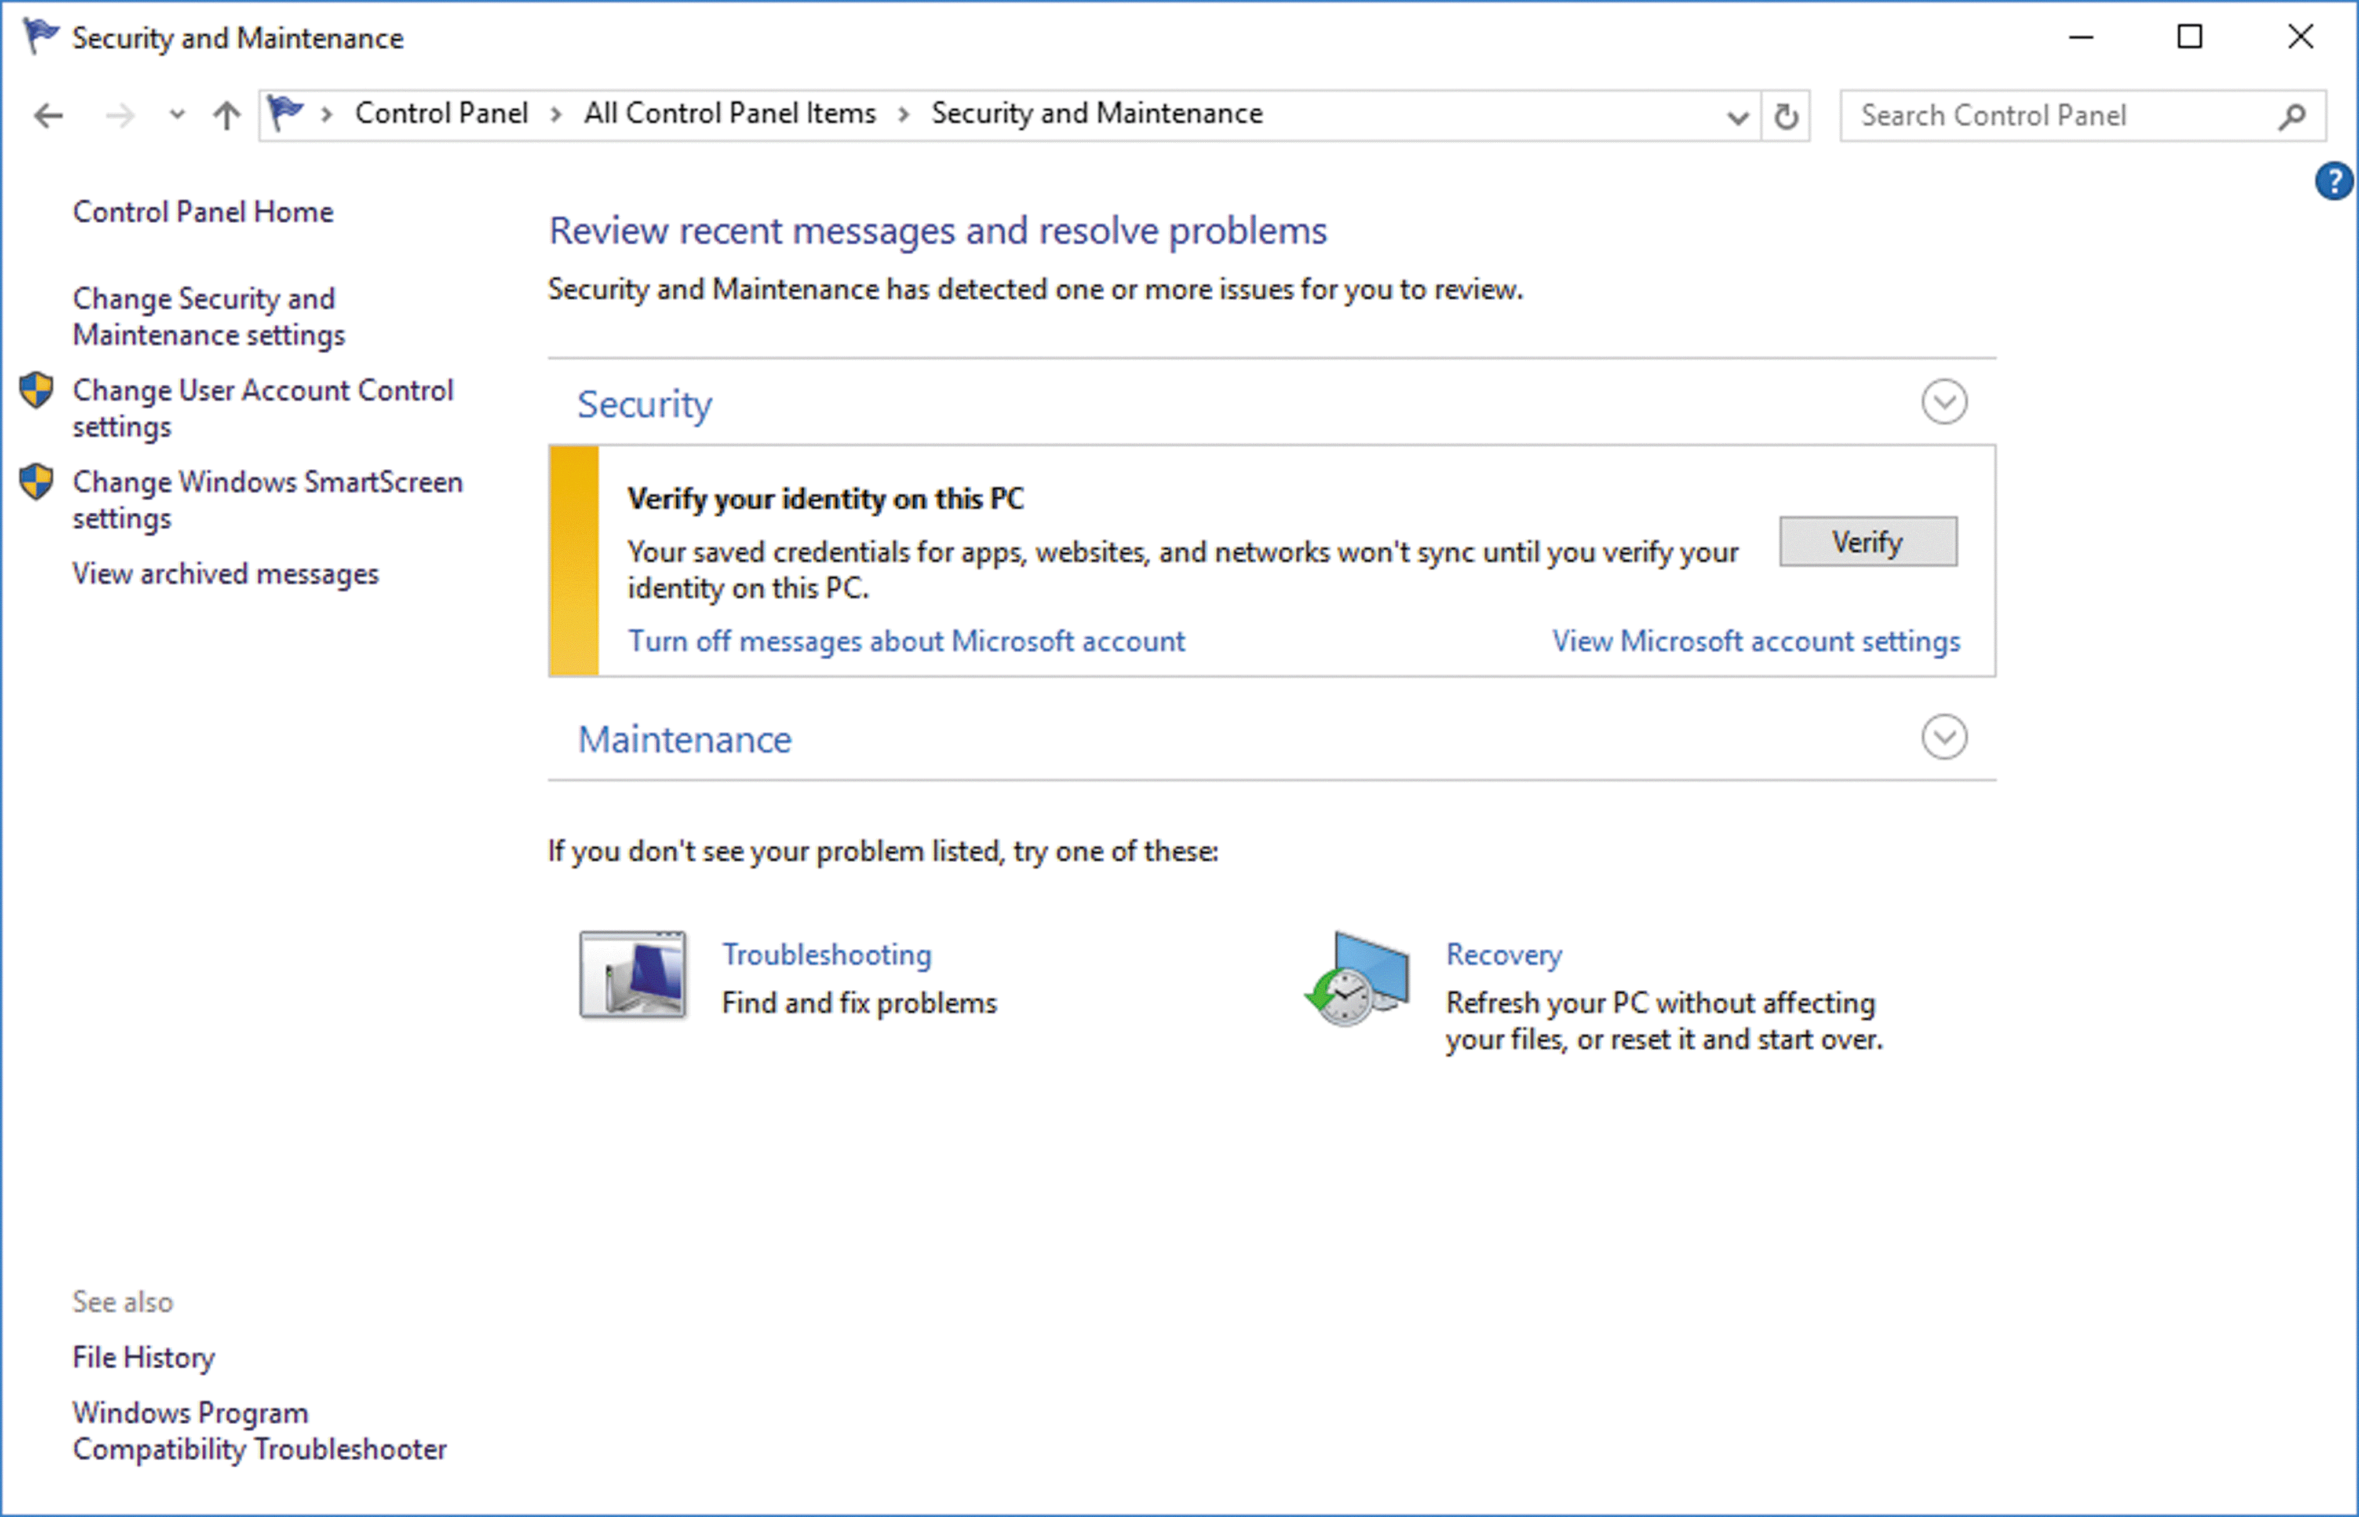
Use Security and Maintenance (Slide 3 of 3)
Security and Maintenance categories

Slide 6
Manage Windows Firewall (Slide 1 of 2)
A firewall is a protective barrier between your computer or network and others on the Internet
Windows Firewall protects your computer from unauthorized access by monitoring Internet traffic
Windows Firewall is enabled by default
Windows SmartScreen Filter blocks malicious websites and downloads
Useful against phishing

Slide 7
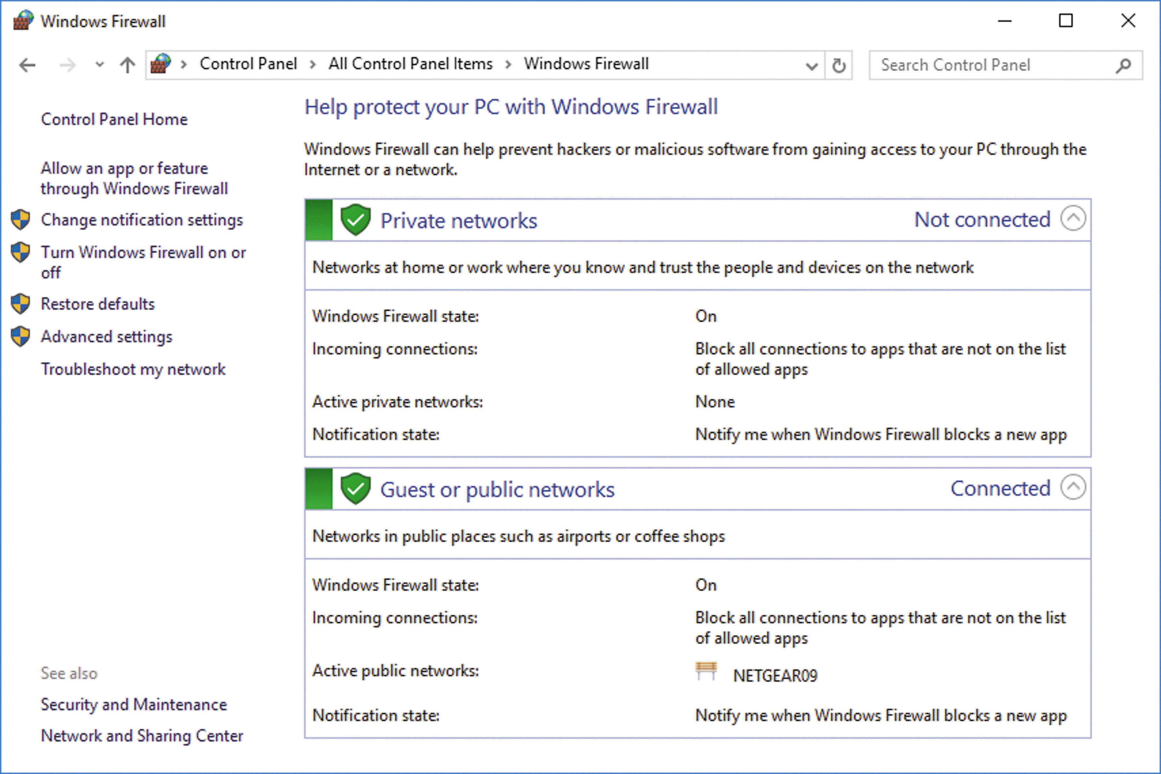
Manage Windows Firewall (Slide 2 of 2)
Windows Firewall window

Slide 8
Manage Automatic Updates (Slide 1 of 2)
Automatic updating provides protection to make sure your Windows software is up to date and safe
Device drivers are programs that control devices attached to your computer
Windows Update is a central location to view installed updates and to install new updates and device drivers

Slide 9
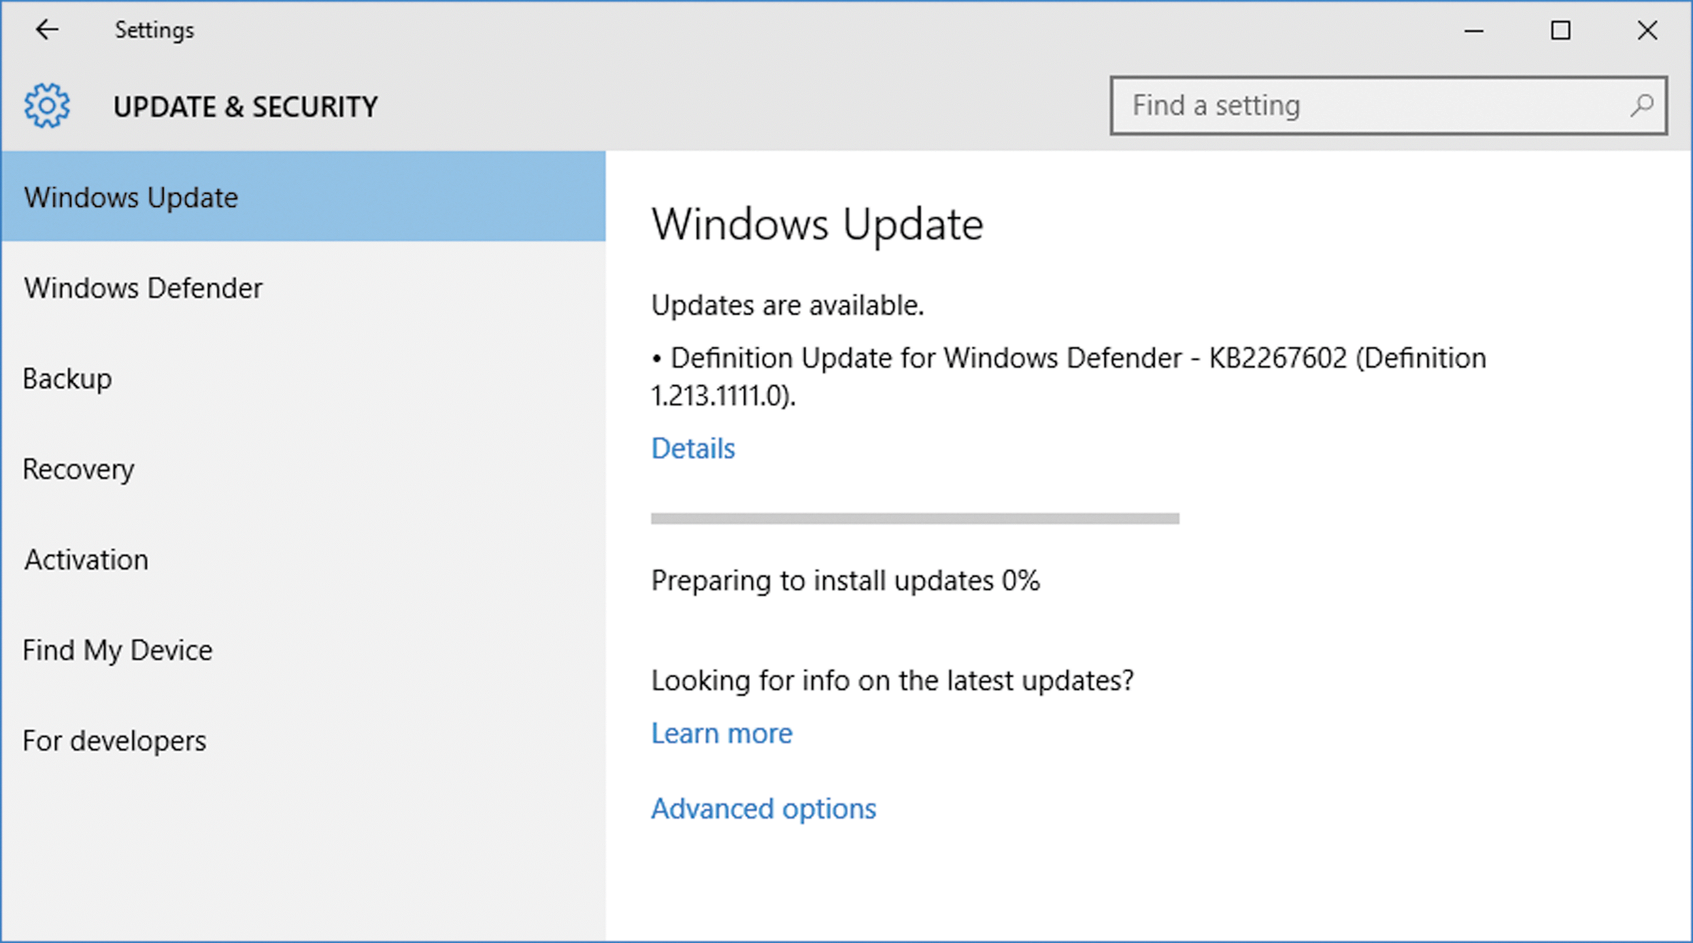
Manage Automatic Updates (Slide 2 of 2)
Checking for available updates

Slide 10
Defend Against Malicious Software (Slide 1 of 2)
Windows Defender provides information and security against malicious software called malware
Spyware is software that attempts to collect personal information or change security settings without your consent
A definition provides instructions on how to defend against malware software
Windows Defender quarantines problem software, which prevents it from running

Slide 11
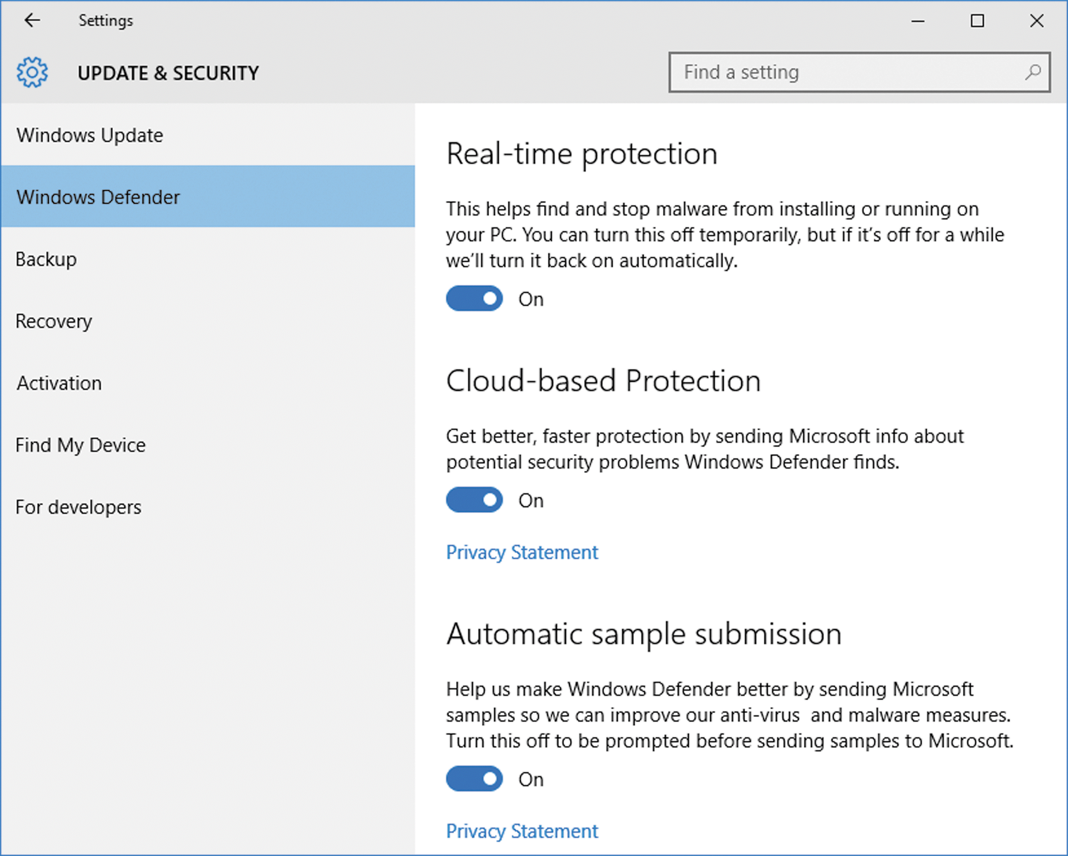
Defend Against Malicious Software (Slide 2 of 2)
Windows Defender in the Settings app

Slide 12
Protect Your Internet Privacy
Web sites can gather information about you without your knowledge
A visited Web site creates a cookie file, known as a first-party cookie, which stores information on your computer, such as your Web site preferences
Third-party cookies are created by Web sites using advertising banners
Windows privacy options allow you to block or permit cookies

Slide 13
Delete Internet Information (Slide 1 of 3)
Microsoft Edge stores information about your activities including
Log on (passwords)
Sites you have visited (history)
Preference information used by websites (cookies)
Webpages, images, and media (temporary Internet files)
To help prevent computer performance problems, periodically delete the Internet files and information

Slide 14
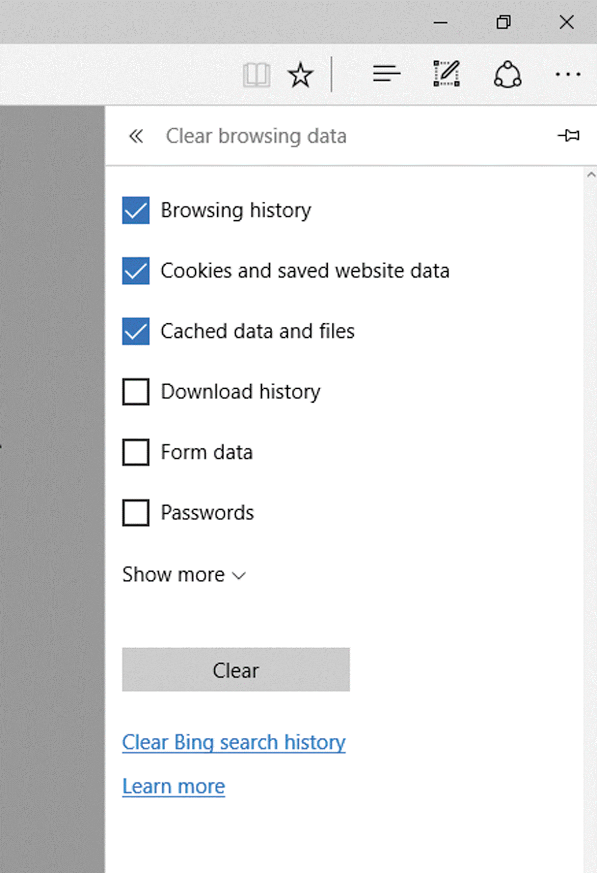
Delete Internet Information (Slide 2 of 3)
Clearing Browsing data

Slide 15
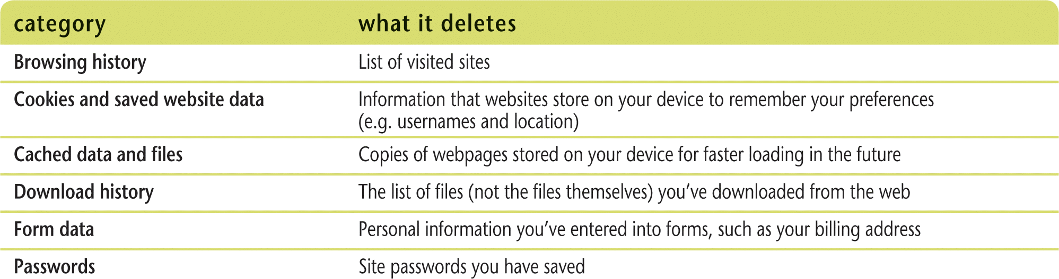
Delete Internet Information (Slide 3 of 3)
Effects of clearing browsing history

Slide 16
Set Family Safety Controls (Slide 1 of 2)
Family Safety helps you manage your child’s access to the Internet, programs, and files on your computer
Web access
Time logged on the computer
Games and apps that can be used
You can create individual settings for each child
You can review activity reports

Slide 17
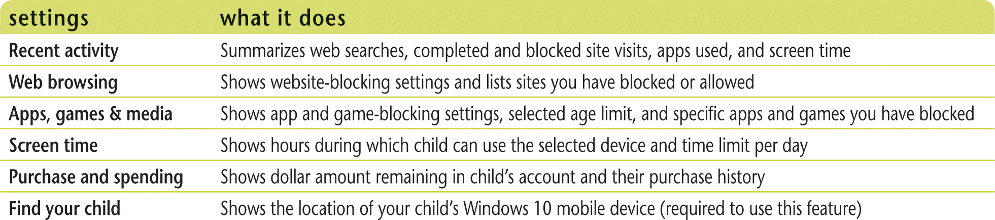
Set Family Safety Controls (Slide 2 of 2)
Family Safety Settings

